Slide 1
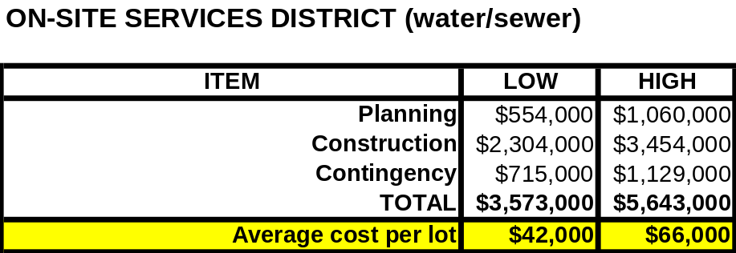
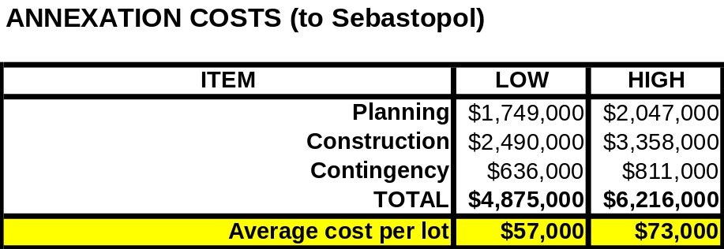
NOVATO
$40,000/home
(only to street connection)
YUCAIPA (S.Cal)
$125,000/home

Slide 3
SONOMA/MARIN
$35-50,000/home
state-of-the-art
NOVATO
$40,000/home
(only to street connection)
YUCAIPA (S.Cal)
$125,000/home

Slide 4
SONOMA/MARIN
$35-50,000/home
state-of-the-art
NOVATO
$40,000/home
(only to street connection)
YUCAIPA (S.Cal)
$125,000/home
ANNUAL COST (Belmont)
$600/yr in 2008
$713/yr in 2013
SEPTIC INSPECTIONS (Marin)
$350/yr

Slide 5
SONOMA/MARIN
$35-50,000/home
state-of-the-art
NOVATO
$40,000/home
(only to street connection)
YUCAIPA (S.Cal)
$125,000/home
ANNUAL COST (Belmont)
$600/yr in 2008
$713/yr in 2013
SEPTIC INSPECTIONS (Marin)
$350/yr
ANNUAL COST (Sebastopol)
$1,500/yr in 2008
$2,300/yr in 2013

